Slide 1
Fast Tag Fraud Detection
By Ruddhi Rani

Slide 2
Project Objective:
Data exploration and preprocessing
Feature engineering
Model development and evaluation
Real-time fraud detection feasibility
Explanatory analysis of factors contributing to fraud
A ML model for detecting fraudulent Fastag transactions.

Slide 3
Introduction:
This project focuses on leveraging machine learning classification techniques to develop an effective fraud detection system for Fastag transactions.
The goal is to create a robust model that can accurately identify instances of fraudulent activity, ensuring the integrity and security of Fastag transactions.

Slide 4
Dataset Description:
1. Transaction_ID: Unique identifier for each transaction.
2. Timestamp: Date and time of the transaction.
3. Vehicle_Type: Type of vehicle involved in the transaction.
4. FastagID: Unique identifier for Fastag.
5. TollBoothID: Identifier for the toll booth.
6. Lane_Type: Type of lane used for the transaction.
7. Vehicle_Dimensions: Dimensions of the vehicle.

Slide 5
Dataset Description:
8. Transaction_Amount: Amount associated with the transaction.
9. Amount_paid: Amount paid for the transaction.
10. Geographical_Location: Location details of the transaction.
11. Vehicle_Speed: Speed of the vehicle during the transaction.
12. Vehicle_Plate_Number: License plate number of the vehicle.
13. Fraud_indicator: Binary indicator of fraudulent activity (target variable).

Slide 6
Data Exploration:
First few rows of the dataset:
Transaction_ID Timestamp ... Vehicle_Plate_Number Fraud_indicator
0 1 1/6/2023 11:20 ... KA11AB1234 Fraud
1 2 1/7/2023 14:55 ... KA66CD5678 Fraud
2 3 1/8/2023 18:25 ... KA88EF9012 Not Fraud
3 4 1/9/2023 2:05 ... KA11GH3456 Fraud
4 5 1/10/2023 6:35 ... KA44IJ6789 Fraud

Slide 7
Summary statistics refer to a set of descriptive measures that provide a quick overview of the main characteristics of a dataset.
These statistics summarize and condense the data, making it easier to understand and interpret.

Slide 8
Data Exploration:
Transaction_ID Transaction_Amount Amount_paid Vehicle_Speed
count 5000.000000 5000.00000 5000.000000 5000.000000
mean 2500.500000 161.06200 141.261000 67.851200
std 1443.520003 112.44995 106.480996 16.597547
min 1.000000 0.00000 0.000000 10.000000
25% 1250.750000 100.00000 90.000000 54.000000
50% 2500.500000 130.00000 120.000000 67.000000
75% 3750.250000 290.00000 160.000000 82.000000
max 5000.000000 350.00000 350.000000 118.000000
Summary Statistics

Slide 9
Data Exploration:
Transaction_ID 0
Timestamp 0
Vehicle_Type 0
FastagID 549
TollBoothID 0
Lane_Type 0
Vehicle_Dimensions 0
Transaction_Amount 0
Amount_paid 0
Geographical_Location 0
Vehicle_Speed 0
Vehicle_Plate_Number 0
Fraud_indicator 0
Missing Values

Slide 10
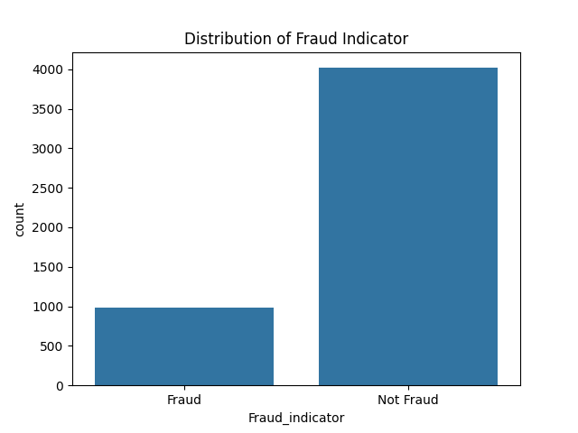

Slide 11
Data Preprocessing and Feature Engineering:
Convert Timestamp to datetime and extract features: Hour, DayOfWeek, Month
One-hot encode categorical variables
Create a new feature: Amount_Difference (Transaction_Amount - Amount_paid)
Drop irrelevant columns

Slide 12
Data after Feature Engineering:
Transaction_Amount ... Amount_Difference
0 350 ... 230
1 120 ... 20
2 0 ... 0
3 350 ... 230
4 140 ... 40

Slide 13
Model Development:
Split the data into features (X) and target variable (y)
Train-test split (70% train, 30% test)
Standardize the data
Initialize and train a Random Forest Classifier

Slide 14
Random Forest Classifier:
A Random Forest Classifier is an ensemble learning method used for classification tasks that builds multiple decision trees during training and outputs the mode (most frequent class) of the classes predicted by individual trees.
This approach helps improve accuracy and control overfitting by averaging multiple decision trees, which reduces variance and bias compared to a single decision tree.

Slide 15
Model Evaluation:
Evaluation Metrics:
Precision:
The ratio of true positive predictions to the total number of positive predictions (true positives + false positives).
Formula: Precision= True Positives/(True Positives+False Positives)
Meaning: Measures the accuracy of positive predictions.

Slide 16
Model Evaluation:
Evaluation Metrics:
Recall:
The ratio of true positive predictions to the total number of actual positives (true positives + false negatives).
Formula: Recall= True Positive/(True Positive+False Negative)
Meaning: Measures the ability to find all the relevant positive cases.

Slide 17
Model Evaluation:
Evaluation Metrics:
F1 Score:
The harmonic mean of precision and recall, providing a balance between the two metrics.
Formula: F1 Score=2×(Precision×Recall) / (Precision+Recall)
Meaning: Combines precision and recall into a single metric for balanced evaluation.

Slide 18
Model Evaluation:
Evaluation Metrics:
Accuracy:
The ratio of correctly predicted instances (both true positives and true negatives) to the total number of instances.
Formula: Accuracy=(True Positives+True Negatives)/Total Instances
Meaning: Measures the overall correctness of the model's predictions.

Slide 19
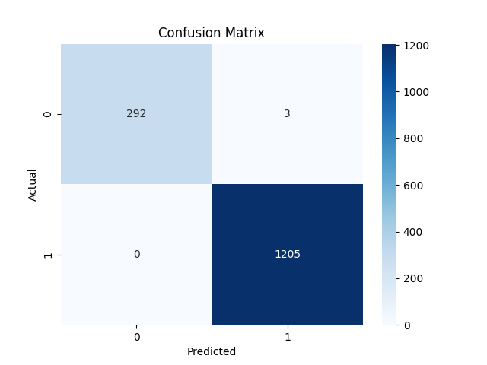

Slide 20
Classification report:
precision recall f1-score support
Fraud 1.00 0.99 0.99 295
Not Fraud 1.00 1.00 1.00 1205
accuracy 1.00 1500
macro avg 1.00 0.99 1.00 1500
weighted avg 1.00 1.00 1.00 1500
These metrics suggest that the model is extremely effective at distinguishing between fraud and non-fraud transactions, with very few errors.

Slide 21
The classification report indicates an almost perfect model performance:
Precision: The model is very accurate in its positive predictions for both fraud and non-fraud transactions.
Recall: The model successfully identifies nearly all actual fraud cases and all non-fraud cases.
F1 Score: The harmonic mean of precision and recall shows excellent balance, especially for the fraud class.
Accuracy: The model correctly classifies all instances in the dataset.

Slide 22
Real-time Fraud Detection Feasibility:
Serializing the model using joblib
Simulating real-time prediction with a sample transaction
Fraud prediction for sample transaction: Not Fraud

Slide 23
Explanatory Analysis:
Explaining the importance of each feature in the model
Displaying the feature importance DataFrame

Slide 24
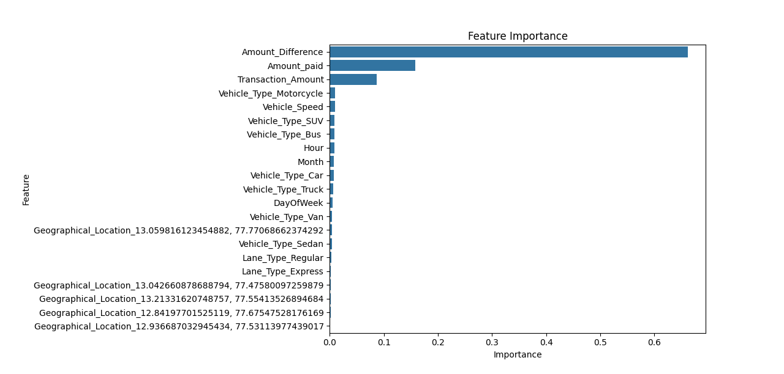

Slide 25
Challenges and Solutions:
Challenges:
Imbalanced dataset
Feature engineering complexity
Solutions:
Use of evaluation metrics suited for imbalanced datasets (e.g., F1 score)
Detailed exploratory data analysis to identify relevant features

Slide 26
Conclusion:
Successful development of a fraud detection model with high accuracy
Key features identified contributing to fraud detection
Real-time prediction feasibility demonstrated

Slide 27
THANK YOU

